Slide 1
Outline
n Importance of Project Cost Management
n What is Project Cost Management?
n Basic Principles of Cost Management
n Four Main Processes
1. Planning Cost Management
2. Estimating Costs
3. Determining the Budget
4. Controlling Costs
n Using Software to Assist in Project Cost Management
2

Slide 2


Importance of Project Cost Management
(1 of 2)
n What is cost?
A resource sacrificed or foregone to achieve a specific objective, or something given up in exchange
Often measured in monetary amounts, such as dollars, that must be paid to acquire goods and services
n Because projects cost money and resources that could be used elsewhere, it is very important for project managers to understand project cost
management
n Cost overrun: additional percentage or dollar amount by which actual costs exceed estimates
n IT projects have a poor track record for meeting budget goals
3

Slide 3

Importance of Project Cost Management
(2 of 2)
n A Harvard Business Review study in 2011 examined IT change
initiatives in almost 1,500 projects and reported an average cost overrun of 27 percent
The study was considered the largest ever to analyze IT projects
Most of these projects incurred high expenses, with an average cost of $167 million and the largest project cost $33 billion
The most important finding was the discovery of many gigantic overages.
One in six of all projects contained a black swan: a high-impact event that is rare and unpredictable, but not improbable in retrospect. These IT black-
swan projects had an average cost overrun of 200% and a schedule overrun of almost 70%!
n IT projects have room for improvement in meeting cost goals
4

Slide 4


What Went Wrong?
n The United Kingdom’s National Health Service IT modernization program was called “the greatest IT disaster” in history
This 10-year program started in 2002 and was created to provide an
electronic patient records system, appointment booking, and a prescription drug system in England and Wales
Britain’s Labor government estimates that the program will eventually cost more than $55 billion, which is a $26 billion overrun.
n The program was plagued by technical problems due to incompatible systems, resistance from physicians, and arguments among contractors about who’s responsible for what.
n The program was scrapped in 2011
5

Slide 5

What is Project Cost Management? (1 of 3)
n Project cost management includes the processes required to ensure that the project is completed within an approved budget
Project managers must make sure that 1) their projects are well defined, 2) have accurate schedule and cost estimates, and 3) have a realistic budget they were involved in approving.
n It is the project manager’s job to satisfy project stakeholders while striving to reduce and control costs continuously
n Four main processes
1. Planning cost management: determine the policies, procedures, and
documentation that will be used for planning, executing, and controlling project cost. Main output: a cost management plan.
2. Estimating costs: develop an approximation or estimate of the costs ofthe resources needed to complete a project. Main outputs: activity cost
estimates, basis of estimates, and project documents updates.
6

Slide 6

What is Project Cost Management? (2 of 3)
3. Determining the budget: allocate the overall cost estimate to individual work items to establish a baseline for measuring performance. Main
outputs: cost baseline, project funding requirements, and project documents updates.
4. Controlling costs: control changes to the project budget. Main outputs: work performance information, cost forecasts, change requests, PM plan updates, and project documents updates.
n To understand each of these processes, the project manager must first understand the basic principles of cost management
Many of these principles are not unique to project management; however, project managers need to understand how they relate to their specific
projects.
7

Slide 7
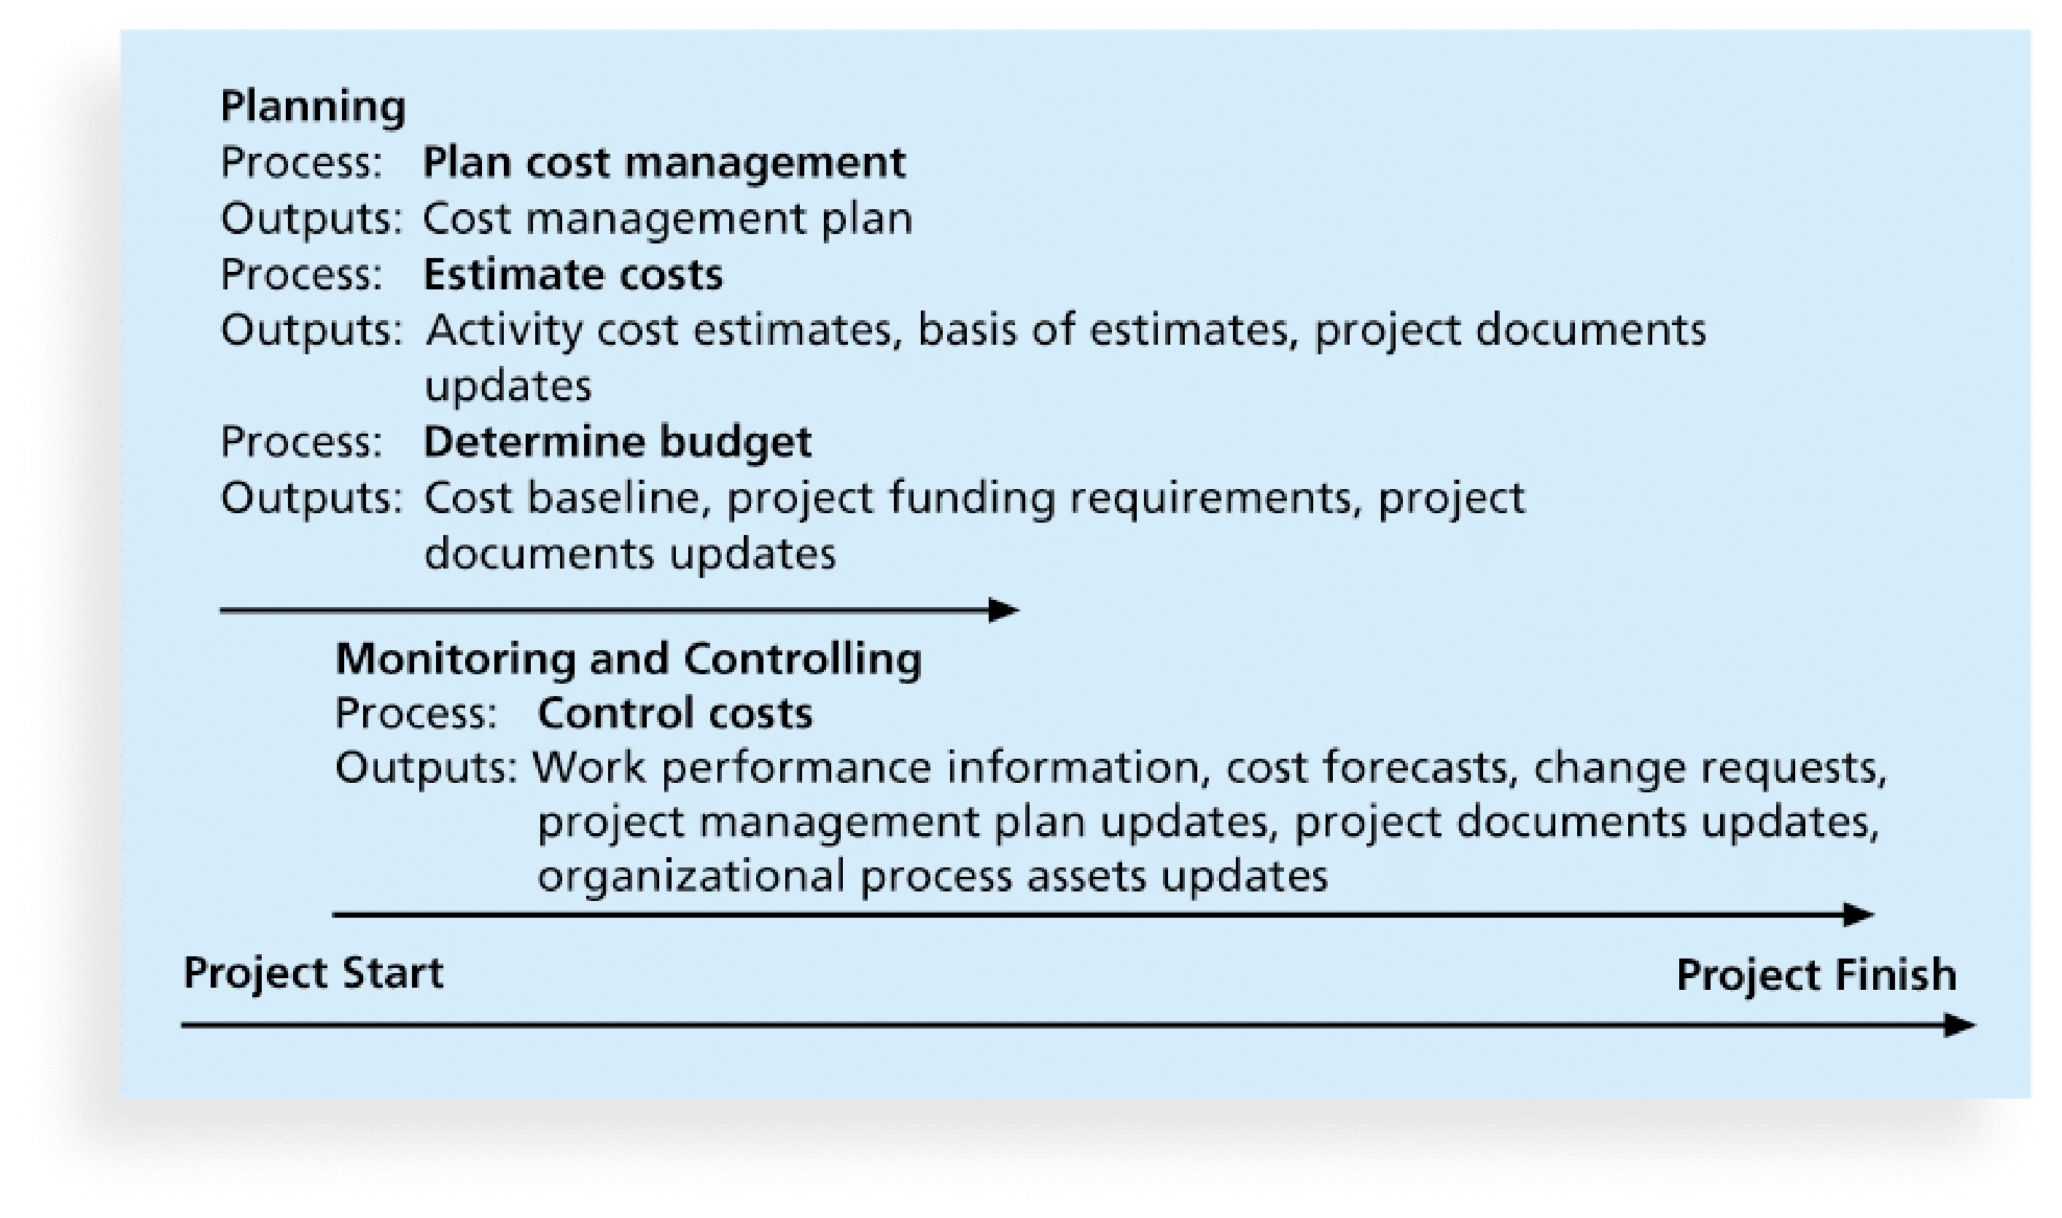
What is Project Cost Management? (3 of 3)
8

Slide 8





Basic Principles of Cost Management (1 of 4)
n IT project managers need to be able to present and discuss project information in both financial and technical terms
Most members of an executive board better understand and are more interested in financial terms than IT terms
Many IT projects are never initiated because IT professionals do NOT know how to develop a financial justification for those projects
Many projects that were started never finish because of cost management problems
n We next introduce several basic principles, concepts, and terms of cost management
Profits, profit margin, life cycle costing, cash flow analysis
Tangible and intangible costs or benefits, direct, indirect and sunk cost
Learning curve theory, reserves (contingency and management)
9

Slide 9



Basic Principles of Cost Management (2 of 4)
n Profits: revenues minus expenditures. To increase profits, a company can increase revenues, decrease expenses, or try to do both.
n Profit margin: ratio of profits to revenues
n Life cycle costing considers total cost of ownership or development plus support costs, for a project
It provides a big-picture view of the cost of a project throughout its life cycle and helps develop an accurate projection of a project’s financial costs and
benefits
Top management and project managers need to consider the life cycle costs of projects when making financial decisions
Organizations have a history of NOT spending enough money in the early phases of projects, which affects total cost of ownership
10

Slide 10

Basic Principles of Cost Management (3 of 4)
n Cash flow analysis: a method for determining estimated annual costs and benefits for a project and resulting annual cash flow
Project managers must conduct cash flow analysis to determine NPV and consider cash flows when selecting projects
n Tangible and intangible costs and benefits
i. Tangible costs/benefits are those easy to measure in dollars.
ii. Intangible costs/benefits are those difficult to measure in dollars (and thus, often harder to justify), such as goodwill, employee morale, etc.
n Direct and indirect costs
i. Direct costs can be directly related to creating the products and services of the project (e.g., salaries and purchase costs). Project managers should
focus on direct costs because they can be controlled.
ii. Indirect costs are NOT directly related to the products or services of the project, but indirectly related to performing work on the project, such as
electricity, pa.pers,informationsystems,etc
11

Slide 11

Basic Principles of Cost Management (4 of 4)
n Sunk cost is money that has been spent in the past
When deciding what projects to invest in or continue, you should not include sunk costs. Consider it gone.
n Learning curve theory states that when many items are produced
repetitively, the unit cost of those items decreases in a regular pattern as more units are produced
n Reserves are dollars included in a cost estimate to mitigate cost risk by allowing for future situations that are difficult to predict
i. Contingency reserves allow for future situations that may be partially
planned for (sometimes called known unknowns) and are included in the project cost baseline. For example, hiring and training costs for replacing resigned team members.
ii. Management reserves allow for future situations that are unpredictable (sometimes called unknown unknowns) and are not included in a project cost baseline. For example, cost of replacing a sick project manager.
12

Slide 12

1. Planning Cost Management (1 of 2)
n The 1st step in project cost management is to plan how the costs will be managed throughout the life of the project
n The project team uses expert judgment, analytical techniques, and meetings to develop the cost management plan
Project costs, like project schedules, grow out of the basic documents that initiate a project, like the project charter.
n Cost management plan includes:
1. Level of accuracy: Activity cost estimates normally have rounding
guidelines (e.g., to the nearest $100). There may also be guidelines for the contingency funds to include (e.g., 10% or 20%).
2. Units of measure: Each unit used in cost measurements, such as labor hours or days, should be defined.
13

Slide 13
1. Planning Cost Management (2 of 2)
n Cost management plan includes (cont’d):
3. Organizational procedure links: Many organizations refer to the WBS
component used for project cost accounting as the control account (CA). Each CA is often assigned a unique code in the organization’s accounting system. Project teams must understand and use these codes properly.
4. Control thresholds: Costs often have a specified amount of variation
allowed before action needs to be taken, such as 10% of the baseline cost.
5. Rules of performance measurement: If the project uses EVM, the cost
management plan would define measurement rules, such as how often actual costs will be tracked and to what level of detail.
6. Reporting formats: the format and frequency of cost reports required for the project
7. Process descriptions: how to perform all the cost management processes
14

Slide 14

2. Estimating Costs
n Project managers must take cost estimates seriously if they want to complete projects within budget constraints
n After developing a good resource requirements list, project managers and their teams must develop several estimates of the costs for these
resources.
Example: if an activity is to perform a test, the list of activity resource
requirements would describe the skill level of the people needed to perform the test, the number of people and hours suggested to perform the test, etc. All this information is required to develop a good cost estimate.
n Three related topics
i. Types of cost estimates
ii. Tools and techniques for estimating costs
iii. Typical problems associated with IT cost estimates
15

Slide 15


Types of Cost Estimates (1 of 4)
n Project managers normally prepare several types of cost estimates for most projects. Three basic types of estimates are ROM estimate,
budgetary estimate, and definitive estimate
1. Rough order of magnitude (ROM) estimate provides an estimate of what a project will cost
Also called ballpark estimate, guesstimate, swag, or broad gauge
Done very early in a project or even before a project is officially started, and its accuracy is typically −50% to +100%
Project managers and top management use this estimate to help make project selection decisions
2. Budgetary estimate is used to allocate money into a firm’s budget
Made one to two years prior to the project completion. Its accuracy is typically from −10% to +25%.
16

Slide 16



Types of Cost Estimates (2 of 4)
3. Definitive estimate provides an accurate estimate of project costs
Used for making many purchasing decisions for which accurate estimates are required and for estimating final project costs
Made one year or less prior to project completion
Most accurate among the three types of estimates: normally −5% to +10%
Type of Estimate | When Done | Why Done | Typical Range
Rough order of magnitude (ROM) | Very early in the project life cycle, often 3–5 years before project completion | Provide estimate of cost for selection decisions | -50% to +100%
Budgetary | Early, 1–2 years out | Put dollars in the budget plans | -10% to +25%
Definitive | Later in the project, less than 1 year out | Provide details for purchases, estimates actual costs | -5% to +10%
Table 7-1 Types of cost estimates
17

Slide 17



Types of Cost Estimates (3 of 4)
n Estimates are usually done at various stages of a project and should become more accurate as time progresses
n Important to provide supporting details for the estimates and updates to project documents
The supporting details include the ground rules and assumptions used in
creating the estimate, a description of the project used as a basis for the estimate, and details on the cost estimation tools and techniques used to create the estimate.
These supporting details should make it easier to prepare an updated estimate or similar estimate as needed.
n Labor costs are an important consideration in preparing cost estimates, because they account for a large percentage of total project costs
Many organizations estimate the number of people or hours they need by department or skill over the life cycle of a project
18

Slide 18
Types of Cost Estimates (4 of 4)
n Full-time equivalent (FTE): a standard way to refer to the total staffing required for a project, regardless of whether people work full time or
part-time
n As an example, Table 7-2 shows the maximum number ofFTE staffa company could assign to a project each year by department.
Department | Year 1 | Year 2 | Year 3 | Year 4 | Year 5 | Totals
Information systems | 24 | 31 | 35 | 13 | 13 | 116
Marketing systems | 3 | 3 | 3 | 3 | 3 | 15
Reservations | 12 | 29 | 33 | 9 | 7 | 90
Contractors | 2 | 3 | 1 | 0 | 0 | 6
Totals | 41 | 66 | 72 | 25 | 23 | 227
Table 7-2 Maximum FTE by department by year
19

Slide 19



Cost Estimation Tools and Techniques (1 of 2)
n Several tools and techniques can assist in developing a good cost estimate
1. Analogous or top-down estimates use the actual cost of a previous
similar project as the basis for estimating the cost of the current project
Requires a good deal of expert judgment and is less costly than other techniques, but also less accurate
Most reliable when the previous projects are similar in fact, not just in appearance
2. Bottom-up estimates, also called activity-based costing, involve
estimating individual work items or activities and summing them to get a project total
Size of the individual work items and experience of the estimators drive the accuracy of the estimates
Usually time-intensive and expensive to develop
20

Slide 20



Cost Estimation Tools and Techniques (2 of 2)
3. Three-point estimates involve estimating the most likely, optimistic, and pessimistic costs for items
We can use a formula like the PERT weighted average described in Lecture
4 to calculate cost estimates or use a Monte Carlo simulation (to be introduced in Lecture 9)
4. Parametric estimating uses project characteristics (parameters) in a mathematical model to estimate project costs
Parametric models are most reliable when the historical information used to create the model is accurate, the parameters are readily quantifiable, and the model is flexible in terms of the project’s size.
For example, many projects involving building construction use parametric estimates based on cost per square foot. The costs vary based on the quality of construction, location, materials, and other factors.
n In practice, combining the above techniques may provide the best cost estimates
21

Slide 21
Typical Problems with IT Cost Estimates
(1 of 2)
n Many IT project cost estimates are very inaccurate, especially those for new technologies or software development
n Four reasons for inaccuracies
1. Estimates are done too quickly. Developing an estimate for a large
software project is a complex task that requires significant efforts. Many
estimates must be done quickly and before clear system requirements have been produced.
2. People lack estimating experience. The people who develop software cost estimates often do not have much experience with cost estimation,
especially for large projects.
3. Human beings are biased toward underestimation. Important for project managers and top management to review estimates and ask important
questions to make sure the estimates are not biased.
22

Slide 22


Typical Problems with IT Cost Estimates (2 of 2)
n Four reasons for inaccuracies (cont’d)
4. Management desires accuracy. Management might ask for an estimate but really want an accurate number to help them create a bid to win a major
contract or get internal funding. It is important for project managers to develop good cost and schedule estimates and use their leadership and negotiation skills to stand by those estimates.
n Be cautious with initial estimates!
Top management never forgets the first estimate and rarely, if ever, remembers how approved changes affect the estimate.
It is a never-ending and crucial process to keep top management informed about revised cost estimates. It should be a formal process, albeit a possibly painful one.
23

Slide 23
How to Develop a Cost Estimate and Basis of Estimates (1 of 3)
n Studying sample cost estimates is one of the best ways to learn how the cost estimating process works
n The textbook provides a step-by-step approach for developing a cost estimate for the Surveyor Pro project described in its opening case
n Several highlights
i. Before estimating costs, the team must gather detailed information about the project and ask how the organization plans to use the cost estimate. Also, important to clarify the ground rules and assumptions.
ii. Because the estimate must be provided by WBS and by month, the team needs to first review a draft of the project schedule.
iii. Crucial to have several people review the project cost estimate.
n Figure 7-2 shows a spreadsheet summarizing the costs by WBS items
Figure 7-3 provides estimate details for the “Software Development” item
24

Slide 24
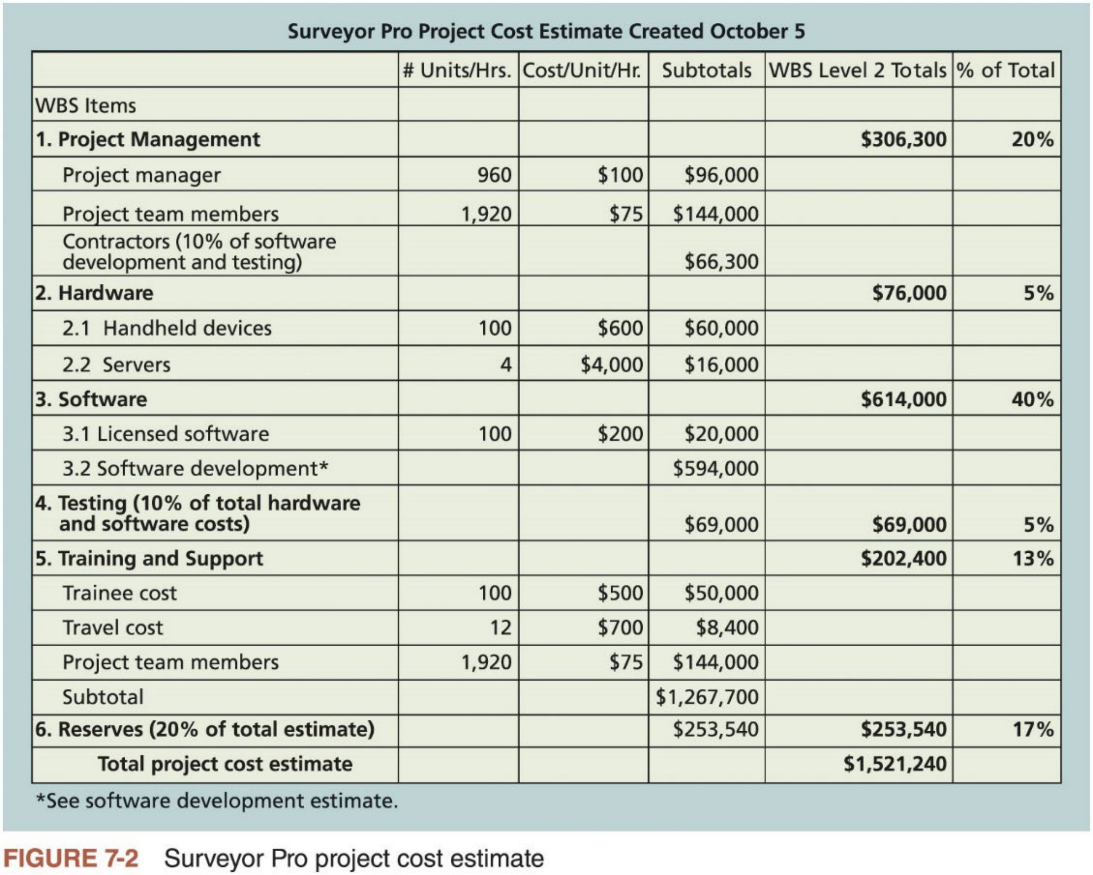
How to Develop a Cost Estimate and Basis of Estimates (2 of 3)
25

Slide 25
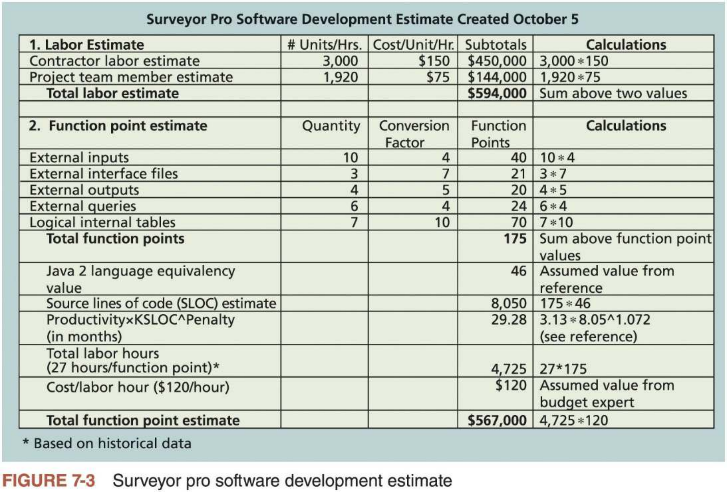
How to Develop a Cost Estimate and Basis of Estimates (3 of 3)
26

Slide 26


3. Determining the Budget (1 of 4)
n Determining the budget involves allocating the project cost estimate to individual material resources or work items, based on the activities in the WBS for the project, over time
n Main goals: produce a cost baseline for measuring project performance and determine project funding requirements
Cost baseline: a time-phased budget project managers use to measure and monitor cost performance. It includes contingency reserves, but not
management reserves.
n Figure 7-4 provides a sample cost baseline, based on the cost estimate from Figure 7-2 and the project schedule
n The project budget is composed of the cost baseline plus management reserve. Figure 7-5 shows its various components.
Most organizations have a well-established process for preparing budgets
27

Slide 27
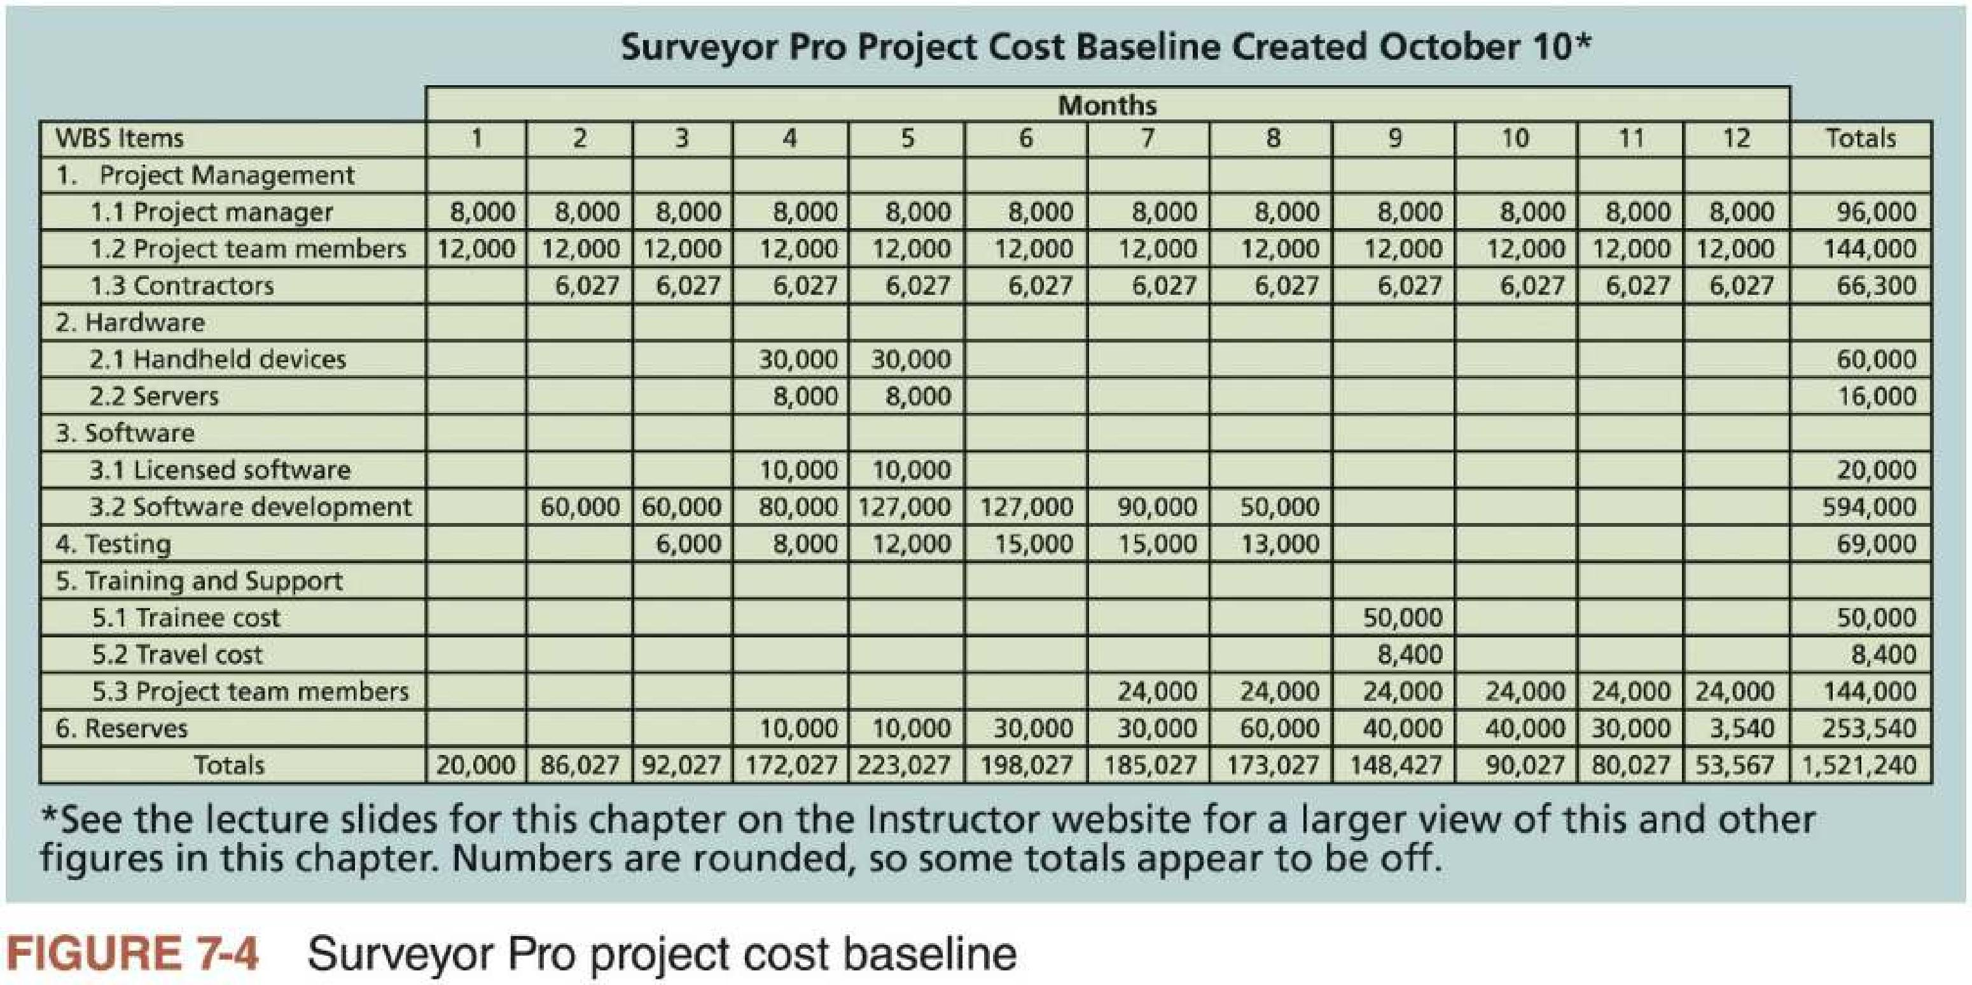
3. Determining the Budget (2 of 4)
28

Slide 28
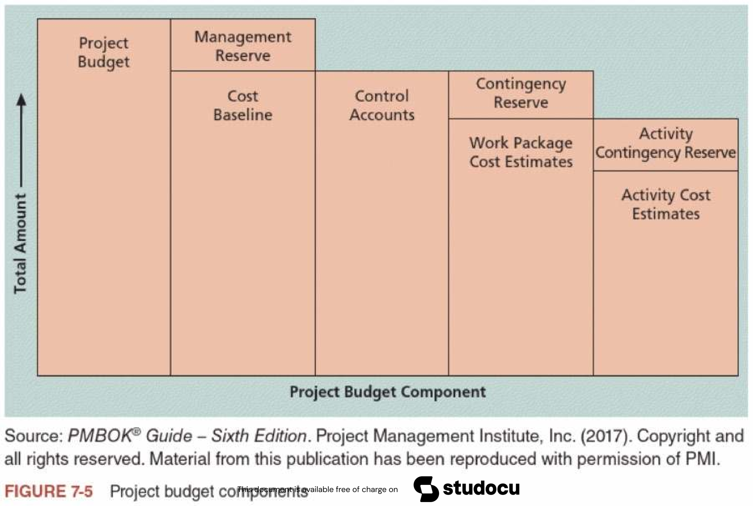
3. Determining the Budget (3 of 4)
29

Slide 29

3. Determining the Budget (4 of 4)
n Important to understand budget categories of an organization before developing an estimate to ensure data is collected accordingly
Budget categories: the number ofFTE for each month (=> staff cost),
purchased goods and services, rents, travel, other supplies and expenses
Organizations use this information to track costs across projects and non-
project work and look for ways to reduce costs. They also use it for legal and tax purposes.
n Cost budgeting provides information for project funding requirements
Some projects have all funds available when the project begins, while others must rely on periodic funding to avoid cash flow problems
n Estimating costs for each major project activity over time provides a foundation for project cost control.
30

Slide 30

4. Controlling Costs
n Controlling project costs involves
i. Monitoring cost performance
ii. Ensuring that only appropriate project changes are included in a revised cost baseline
iii. Informing project stakeholders of authorized changes to the project that will affect costs
n Tools and techniques for project cost control
Expert judgment, data analysis, PM information systems
Earned Value Management (EVM)
31

Slide 31

Earned Value Management (EVM) (1 of 6)
n EVM is a project performance measurement technique that integrates scope, time, and cost data
Given a cost performance baseline, project managers can use it to determine how well the project is meeting scope, time, and cost goals by comparing the actual information to their baselines
Actual information includes 1) whether a WBS item was completed, 2)
approximately how much of the work was completed, 3) when it started and ended, and 4) how much the completed work cost.
n EVM calculates three base values for each activity or summary activity from a project’s WBS
1. Planned value (PV): the authorized budget assigned to scheduled work
2. Actual cost (AC): the realized cost incurred for the work performed on an activity during a specific period of time
3. Earned value (EV): the measure of work performed expressed in terms of the budget authorized for that work
32

Slide 32

Earned Value Management (EVM) (2 of 6)
n Performance variances and indexes
1. Cost variance (CV): Earned Value (EV) minus Actual Cost (AC)
2. Cost performance index (CPI): the ratio of EV to AC
3. Schedule variance (SV): Earned Value (EV) minus Planned Value (PV)
4. Schedule performance index (SPI): the ratio of EV to PV
n Estimate at completion (EAC): the ratio of BAC to CPI (or SPI)
Budget at completion (BAC): the original total budget in terms of cost or time for the project
n Estimated to Complete (ETC): EAC minus AC
n To-complete performance index (TCPI): a measure of the cost or time
performance that must be achieved in the future to achieve a specific goal such as BAC
To meet on plan or meet the BAC: TCPI = (BAC-EV)/(BAC-AC)
33

Slide 33
Earned Value Management (EVM) (3 of 6)
Term | Formula
Earned value (EV) | EV = PV of all completed work
Cost variance (CV) | CV = EV – AC
Schedule variance (SV) | SV = EV – PV
Cost performance index (CPI) | CPI = EV/AC
Schedule performance index (SPI) | SPI = EV/PV
Estimate at completion (EAC) – Cost | EAC = BAC/CPI
Estimate at completion (EAC) – Time | EAC = BAC/SPI
Estimated to Complete (ETC) | ETC = EAC – AC
To-complete performance index (TCPI) | TCPI = (BAC-EV)/(BAC-AC)
Table 7-4 Earned value formulas
34

Slide 34
Earned Value Management (EVM) (4 of 6)
n Table 7-3 shows an example of earned value calculations
Suppose a project included a summary activity of purchasing and installing a new web server. According to the plan, it would take one week and cost a
total of $10,000 for the labor hours, hardware, and software. Baseline
It took two weeks and cost $20,000 to complete the activity: $15,000 was
incurred in week 1 and $5,000 was incurred in week 2. Actual performance
Activity | Week 1
Earned value (EV)
Planned value (PV)
Actual cost (AC)
Cost variance (CV)
Schedule variance (SV)
Cost performance index (CPI)
Schedule performance index (SPI)
Estimate at Completion (EAC)
Estimated to complete (ETC)
Table 7-3 Earned value calculations for one activity after week 1
35

Slide 35
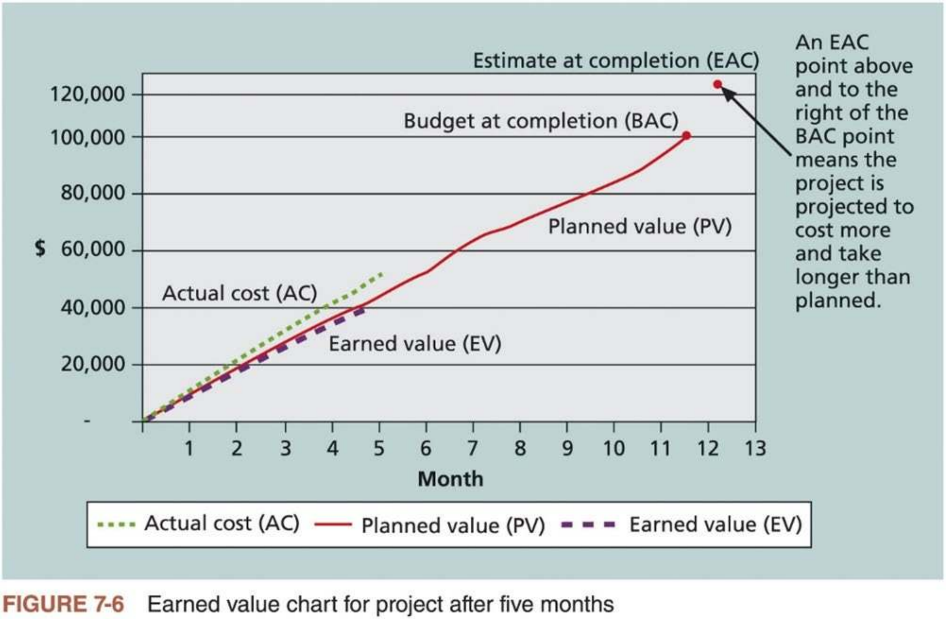
Earned Value Management (EVM) (5 of 6)
n Figure 7-6 shows an earned value chart for a one-year project after five months
36

Slide 36
Earned Value Management (EVM) (6 of 6)
n In general, negative numbers for cost and schedule variance indicate
problems in those areas. Likewise, a CPI and an SPI of less than one also indicate problems.
n EVM is the primary method available for integrating performance, cost, and schedule data
Helps top management and project managers evaluate progress and make sound management decisions
For example, earned value charts allow you to see quickly how projects are performing. The EACs are important inputs to budget decisions, especially if total funds are limited.
n The heart and soul of EVM are estimates
Before an organization attempts to use EVM, it must learn to develop good estimates.
37

Slide 37
Global Issues (1 of 2)
n PMI conducted a major study in 2010 which surveyed more than 600 project management practitioners in 61 countries, providing a cross- sectional view of the most current EVM practices
n Several key findings
i. EVM is used worldwide, particularly popular in the Middle East, South Asia, Canada, and Europe
ii. Most countries require EVM for large defense or government projects, as shown in Figure 7-7
iii. EVM’s contributions and cost effectiveness are widely recognized
iv. Top barriers to enhanced use of EVM: lack of motivation and lack of expertise
v. Most important success factors: top management support, buy-in of
project staff, training, organizational culture and leadership, and maturity of the project management system
38

Slide 38
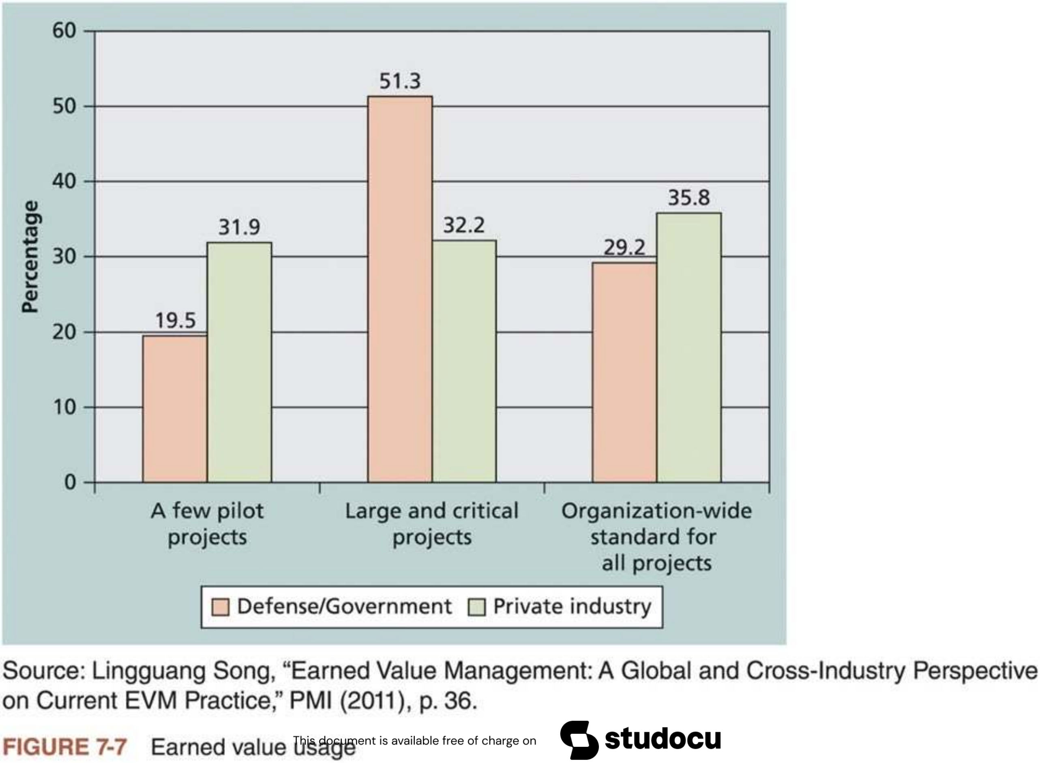
Global Issues (2 of 2)
39

Slide 39
Project Portfolio Management (1 of 2)
n Many organizations collect and control an entire suite of projects or investments as one set of interrelated activities in a portfolio
n Project managers need to understand how their projects fit into the
bigger picture. Looking at broad categories of similar projects enables them to help their organizations make wise investment decisions.
n Five levels of project portfolio management
1. Put all your projects in one database
2. Prioritize the projects in your database
3. Divide your projects into two or three budgets based on type of investment, such as required systems, incremental upgrades, and strategic investments
4. Automate the repository
5. Apply modern portfolio theory, including risk-return tools that map project risk on a curve
40

Slide 40
Project Portfolio Management (2 of 2)
n Understanding project portfolio management is important for both project and organizational success
An organization’s many projects may be overlapped, and different projects may try to accomplish the same thing.
IT investments are huge, risky investments.
Many project managers want to move on to manage larger projects, become program managers, then vice presidents, and eventually CEOs.
n Project portfolio managers can start by using spreadsheet software to develop and manage project portfolios, or use sophisticated software designed to help manage project portfolios.
41

Slide 41

Using Software to Assist in Project Cost Management (1 of 2)
n Spreadsheets are a common tool for resource planning, cost estimating, cost budgeting, and cost control
n Many companies also use more sophisticated and centralized financial software to provide important cost-related information
n PM software can increase a project manager’s effectiveness during each process of project cost management
Microsoft Project has many cost management features, including earned value management.
n Many IT project managers use other tools to manage cost information
because they either do not know that they can use PM software or do not track costs based on a WBS, as most PM software does.
42

Slide 42


Using Software to Assist in Project Cost
Management (2 of 2)
n Enterprise or project portfolio management (PPM) tools integrate
information from multiple projects to show the projects’ status and health
n Recent Studies on PPM Software
A 2017 Gartner report says the market for PPM software continues to grow, with annual sales over $2.3 billion.
A study by Forrester estimates that companies are achieving returns of 250 percent from their investments in PPM tools.
Pfizer and Ford use PPM software to improve transparency ofthe many projects they manage.
n Managers must make sure that the data is accurate and up to date and ask pertinent questions before making any major decisions.
43

Slide 43
Complementary Reading
n Chapter 7 “Project Cost Management” of Schwalbe (2018)
n Chapter 7 “Project Cost Management” in Part 1 of PMBOK® Guide (2017)
44

